Slide 1
World Music Pedagogy: An Introduction
Jui-Ching Wang (jcwang@niu.edu)
王瑞青
School of Music, Northern Illinois University, DeKalb, IL.
June 8 2012

Slide 2
Music education in a society
Educational settings
Systematic (institutions)
Framed within a set of complex societal, artistic, and educational principles
When music teachers (musicians) care enough to commit themselves to imparting musical techniques, repertoire, and meaning, music learning results.
Good teachers know their music, and they understand the musical needs of their students.
The making of music strongly reflects how it has been learned, and is informed by the particulars of its transmission—the
What
Who
Why
Where
How

Slide 3
World music activities
Tapping irregular rhythms (Turkish, Korean)
Balinese Marching Gamelan
Balinese KeCak (Monkey Chant)
Tari Saman (Thousand hands dance)
Listening to native American flute music (Kokopelli)

Slide 4
Walk
Walk
Walk
Jump and stop
Are you ready?

Slide 5
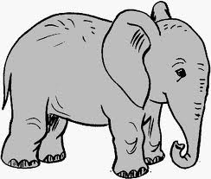
Odd and Even… Here they come!

Slide 6
Dere Geliyor (Turkish Folk Song)
This is a very, very old traditional Turkish folk song which uses the 9/8 rhythm.
It is a bit slower than most songs that are based on this rhythm.
It describes a person who is frustrated because time is passing by, and she/he is not yet married.
The origin place of this song might be close to a river that overflows periodically because as suggested in the texts, when the river overflows it indicates that still more time has passed.
The word "Aman" itself doesn’t really mean anything—it’s an exclamation that is used when someone is frustrated.

Slide 7
Turkish Lyrics | English Translation
Verse 1: | Verse 1:
Dere geliyor dere, yalelel yalelel | The river is overflowing,
Kumunu seresere, yalelellim. | Spreading sand,
Al beni götür dere, yalelel yalelel | O river, take me with you
Yarın olduğu yere, yalelellim. | To where my beloved is.
Chorus: | Chorus:
Amanın aman aman | O mercy,
Zamanın zaman zaman | O time,
Bizim dügüne zaman yalelellim. | When will our wedding be?
(Repeat above 3 lines) | (Repeat above 3 lines)

Slide 11
Samai
I’qa Samai is commonly used for Classical Arabic love songs and also with the Samai instrumental form.

Slide 12
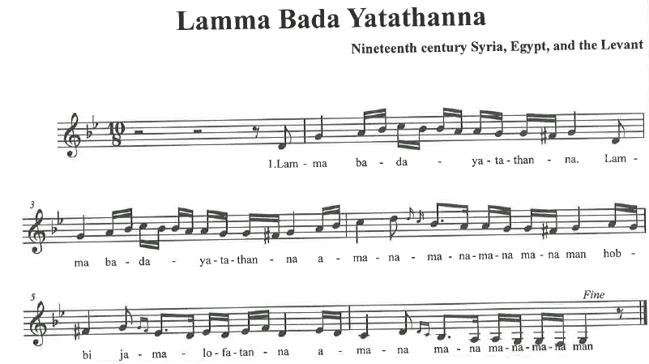

Slide 13
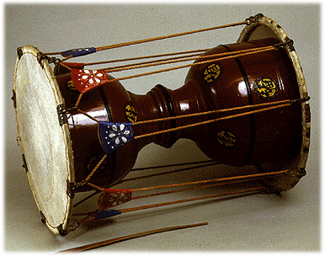
Chang gu drum
This major percussion instrument is used for both folk and court music.
Right-hand skin is played with a stick; left-hand skin, with the hand.
In many outdoor folk dances, a heavier bamboo stick is used on the right and a mallet with a wooden ball on the left.
Drum accompaniment for Arirang

Slide 14
About the song
Arirang is one of the most well-known Korean folk songs. The Arirang Gorge in the text is an imaginary rendezvous of lovers in dreamland, although there is a real mountain pass called “Arirang Gorge,” outside the small East Gate of Seoul. The tune is melancholy and gained great fame after a silent film of the same title was produced by Na Un-Gyu in 1926. It became a symbol of the struggle for independence against Japanese colonization (1910-1945).
Text Translation
Arirang, Arirang, Arariyo. Arirang Pass is the long road you go.
If you leave and forsake me. Before you have gone three miles, you will be lame.

Slide 15
Gamelan Bebonangan/Beleganjur (marching gamelan)
The marching gamelan consists of the gong, cymbals, and drum players.
Nearly every ceremony calls for a procession often more than one.
E.g., cremation or temple festivals (the annual temple ceremonies).
Instrumentation:
Various sizes of gongs, cymbals, and drums.
Most of the instruments play in interlocking patterns.

Slide 16
Marching gamelan tune
Beat | 1 | 2 | 3 | 4 | 5 | 6 | 7 | 8
Kettle 5 | x |  |  | x |  | x
Kettle 3 |  |  | x |  |  |  |  | x
Kettle 2 |  | x |  | x |  |  | x
Kettle 1 |  |  |  |  | x
Gong | x |  |  |  | x
Cymbal 1 | xo |  | xo |  | xo |  | xo
Cymbal 2 |  | xo |  | xo |  | xo |  | xo
Drum | X | X | X | X | ox | ox | ox | ox
This is based on the pentatonic scale , Do, Re, Mi, Sol or Ding Dong Deng Dung, the Balinese solfegee.

Slide 17
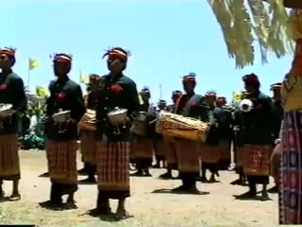
Gamelan beleganjur contest performance, Bali, Indonesia, 2005 http://www.youtube.com/watch?v=28-5r9-BdwQ

Slide 18
WHY? World Music in Schools?

Slide 19
World music pedagogy
Why?
Changing demographics, societal forces, and multicultural mandates have begun to turn educators toward viewing their educational missions in more inclusive terms, and to searching for a wider variety of musical sources for their teaching repertoire.
http://www.youtube.com/watch?v=f6mr12zroxA
http://www.youtube.com/watch?v=oumVHSj6AE8&feature=related

Slide 20
World music pedagogy, cont’d
Who and What?
Ethnomusicologists
Study music in culture and music as culture, including the art, traditional, tribal, and popular musical cultures of nearby neighborhoods as well as those of remote
Teach music from perspectives in anthropological theory, musical and cultural analyses
Music educators (music teachers at K-12 and college levels)
Study educational/psychological rationales of teaching and learning music, teaching methods, curriculum design, etc.
Teach music (primarily and traditionally Western/European art music tradition)
The two streams of music professionals have accomplished much in their specialized work, and prospects for the crossing of their areas of expertise are rich with possibilities for the phenomenon of world music pedagogy.
Dr. Patricia Campbell (the University of Washington, School of Music, Seattle, WA, USA)

Slide 21
World music pedagogy, cont’d
How
How music is taught/transmitted and received/learned within cultures
How the processes included in significant musical practices within these cultures can be preserved or at least partially retained in classrooms and rehearsal halls.

Slide 22
World music pedagogy, cont’d
How, cont’d
Music can be best understood through experience with the manner in which it is taught and learned.
Ethnomusicologists and music educators have worked to blend the expertise and insights of the two into a pedagogical system that is sensitive to transmission systems within the culture.

Slide 23
World music pedagogy, cont’d
How, cont’d
E.g.: they are conscious of and pay tribute in their teaching to other notational systems, oral/aural techniques, improvisatory methods that may be integral to a style, and even what customary behaviors precede and immediately follow lessons and sessions within particular traditions.

Slide 24
World music pedagogy, cont’d
How, cont’d
Understanding of musical pieces through deep and continued
Listening
Participatory
Performance
Creative experience
Study of its cultural context and meaning

Slide 25
World music pedagogy, cont’d
How, cont’d
The study of music and culture, with culture interpreted as both old (original culture of the music) and new (instructional culture), is the essence of world music pedagogy.
The “how” of world music pedagogy requires bridging the two cultures.

Slide 26
World music pedagogy, cont’d
How, cont’d
Ethnomusicology
Continue to develop its scholarly courses through interdisciplinary themes and theoretical analyses to understand music as human expression.
Music Education
Continue to develop instruction to guide learners of all ages in knowing music for its composite aesthetic, expressive, and historical-cultural aims.

Slide 27
World music pedagogy, cont’d
Current trend:
the blending of expert and committed scholars, musicians, and teachers forge their collective interests into a scholarship of teaching that is reflective of the available knowledge on music, culture, and instructional/learning processes.

Slide 28
Learning styles
A multi-sensory learning experience:
the aural, visual, and kinesthetic capacities
students listen, observe, and imitate the teacher or master musician in lessons and sessions.
as they listen to the performance of the masters, they watch and finally become active themselves in the kinesthetic process of performance.
musicians around the world carefully exercise their aural capacities as they develop their technical skills to their maximum potential.

Slide 29
Learning styles, cont’d
Students in the classroom
How did you learn?
How will you teach?
Two styles:
Teacher-centered
Student-centered
A better way to teach music…
Students at all levels learn well by listening
Lowell Mason: Teach “sound before symbol.”
Students learn music best by observing musical practice, listening to it, and then attempting to imitate it.
…step-by-step musical performance and participation experiences for students are more directly the point of their musical learning.

Slide 30
Learning styles, cont’d
Music
as music, the aural art, and certain avenue of self-expression,
can be best understood by knowing its structures and meanings through live and recorded sources.
Listening
attentive and focused
can help develop thoughtful music-making experiences to aurally-informed performances.

Slide 31
Learning styles, cont’d
Students in the classroom
How did you learn?
Activity:
Learn to sing traditional Balinese KeCak (monkey chant).
Describe the strategies undertaken in doing so. Discuss whether there are occasions for learning music through notation or aural/oral means, and what benefits and deficits there are to either way.

Slide 32
Oral/aural techniques
Two important components in an oral transmission:
Teacher’s facilitation of sound sources
Students’ aural perception
Whether the music to be taught and learned is preserved in notation or not, oral and aural means remain central to the discovery of essential features of a song or an instrumental piece.

Slide 33
Oral/aural techniques, cont’d
Notation
Enhances listening experiences
Provides a graphic map to melodic and rhythmic components
However, attention to the musical sound itself is the surest way to knowing music analytically and for its performance possibilities, for example:
Tempo rubato
Expression
Phrasing

Slide 34
Oral/aural techniques, cont’d
Teacher-Student Practice = Modeling-and-imitation strategy
The expert or master musician-teacher sings or plays a musical section with the intent of demonstrating to the student not only rhythm and/or melody but every intricate expressive element that cannot be fully captured in notation.

Slide 35
Oral/aural techniques, cont’d
How about in a public school classroom?
Look for other musical sources and resources
Cultural bearers, musicians living and working in the community, are contracted as teachers of musical diversity.
Recordings: models of musical sounds can be played repeatedly allowing learners with multiple chances to master one phrase after the other
Video-recordings
Even better models of some traditions where the visuals may underscore and complement the aural information, or when movement is integral to the music

Slide 36
Oral/aural techniques, cont’d
An experience of musicking
The goal of performance is to help students understand the music through listening analysis
E.g. singing and rhythmically chanting musical phrases and patterns draw students immediately into the musical center of a work.
Teachers can utilize oral/aural strategies with considerable frequency to engage students in participatory experiences, knowing that the greater the participation of the students, the more deeply their musical understanding may be.

Slide 37
Oral/aural techniques, cont’d
An experience of musicking
The goal of performance is to help students understand the music through listening analysis
E.g. singing and rhythmically chanting musical phrases and patterns draw students immediately into the musical center of a work.
Teachers can utilize oral/aural strategies with considerable frequency to engage students in participatory experiences, knowing that the greater the participation of the students, the more deeply their musical understanding may be.

Slide 38
Functions of Music
Emotional expression
Aesthetic enjoyment
Entertainment
Communication
Physical response
Enforcement of conforming to social norms
Music is used to provide instructions or warnings (adult initiated)
Validation of religious rituals
Continuity and stability of culture
Linking them to their cultural heritage and reflecting the values of their ethnic culture
Integration of society
Brings children together and unites them within a society

Slide 39
Learning
Enculturative, natural and without formal instruction
Partly guided
Highly structured and sequential in process

Slide 40
Music at school because…
Every student, regardless of family resources, deserves a chance to participate in music
Musicking– the ways students experience music
Doing
Integrating
Combining more than a single means of experiencing music
Singing
Moving
Playing
Listening
Playing with music (play helps them develop understanding)

